Slide 1

Chapter 11
Cost Behavior, Operating Leverage, and Profitability Analysis

Slide 2
LO 11-1:
Identify and describe fixed, variable, and mixed cost behavior.

Slide 3
Fixed Cost Behavior
Considering cost behavior enables managers to more effectively plan and control costs.
Total versus per-unit fixed costs behave differently.
The total cost remains constant (fixed).
Fixed cost per unit decreases as volume increases.
The term fixed cost is consistent with the behavior of total cost.

Slide 4
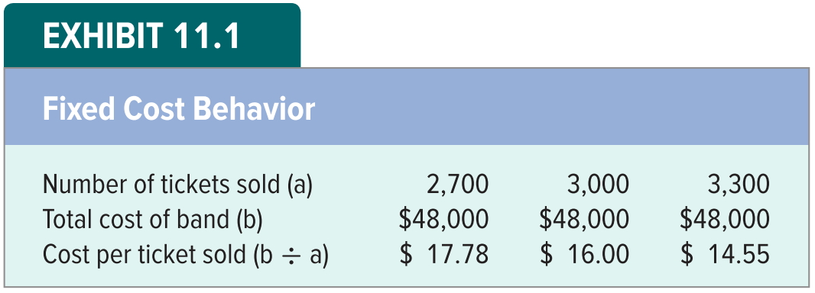
Fixed Cost Behavior
SPI specializes in promoting rock concerts.
It is considering paying a band $48,000 to play a concert.
Exhibit 11.1 illustrates the fixed cost behavior pattern.

Slide 5
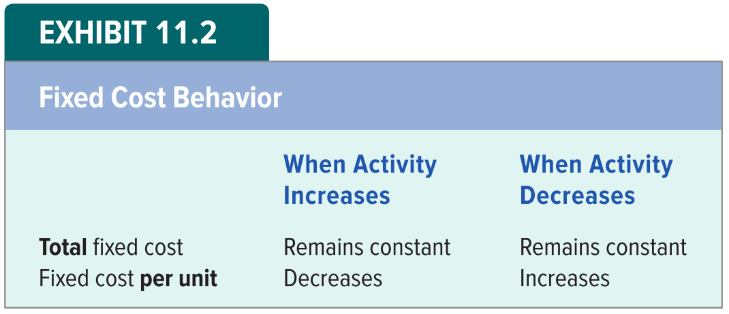
Fixed Cost Behavior

Slide 6
LO 11-2:
Demonstrate the effects of operating leverage on profitability.

Slide 7
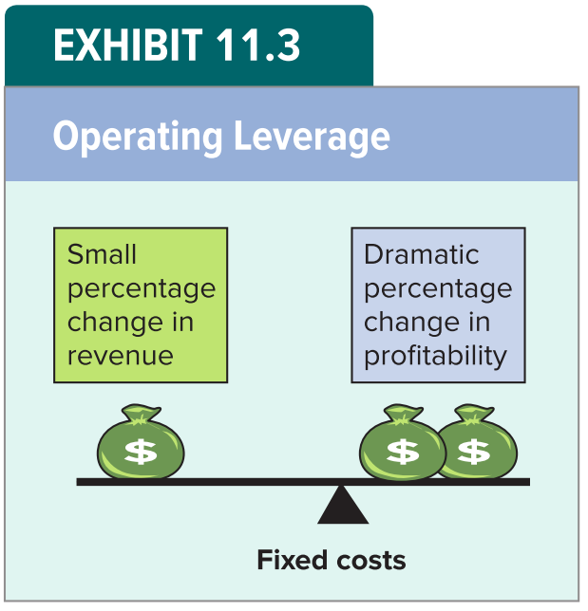
Operating Leverage
Business managers apply operating leverage to magnify small changes in revenue into dramatic changes in profitability.
The lever managers use to achieve disproportionate changes between revenue and profitability is fixed costs.

Slide 8
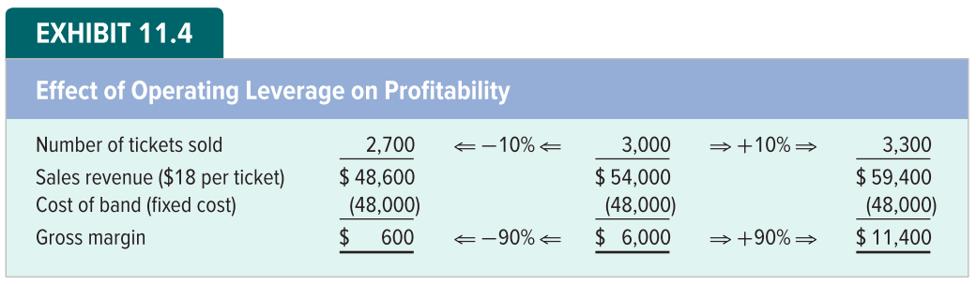
Effect of Operating Leverage on Profitability – Decrease in Revenue

Slide 9
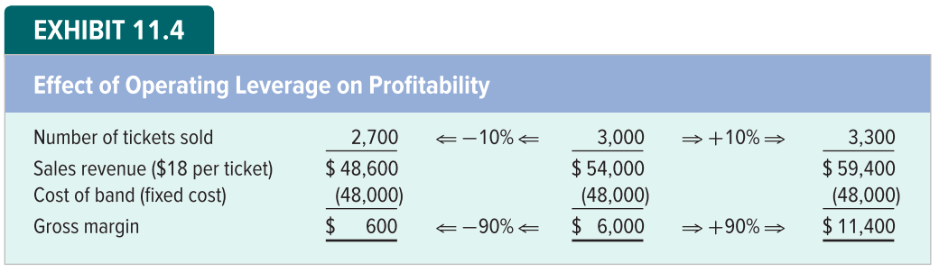
Effect of Operating Leverage on Profitability – Increase in Revenue

Slide 10
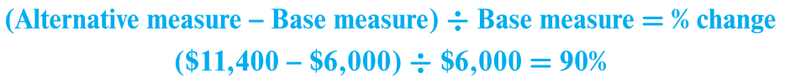

Calculating Percentage Change
The percentages in Exhibit 11.4 are computed as follows:
Compute the percentage change in gross margin when moving from 3,000 units to 3,300 units:
The percentage decline in profitability is computed as:

Slide 11
Risk and Reward Assessment
Risk refers to the possibility that sacrifices may exceed benefits.
A fixed cost represents a commitment to an economic sacrifice.
It represents the ultimate risk of undertaking a particular business project.
If SPI pays the band but nobody buys a ticket, the company will lose $48,000.
SPI can avoid this risk by substituting variable costs for the fixed costs.

Slide 12
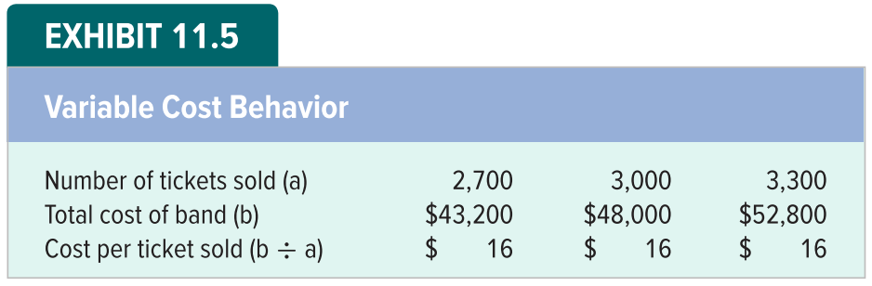
Variable Cost Behavior
SPI arranges to pay the band $16 per ticket sold instead of a fixed $48,000.
Exhibit 11.5 illustrates the variable cost behavior pattern.

Slide 13
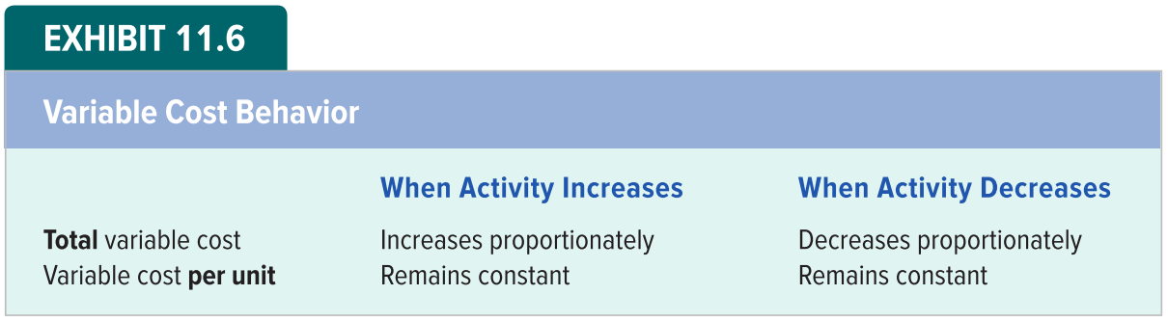
Variable Cost Behavior

Slide 14
Variable Cost Behavior Continued
Since SPI will pay the band $16 for each ticket sold, the total variable cost increases in direct proportion to the number of tickets sold.
The variable cost per ticket remains $16 regardless of whether the number of tickets sold is 1, 2, 3, or 3,000.
The behavior of variable cost per unit is contradictory to the word variable.
Variable cost per unit remains constant regardless of how many tickets are sold.

Slide 15
Risk and Reward Assessment
Shifting the cost structure from fixed to variable enables SPI to avoid the fixed cost risk.
Under the fixed cost structure, SPI was locked into a $48,000 cost for the band regardless of how many tickets are sold.
If no tickets are sold, SPI will have to report a $48,000 loss on its income statement.
The risk of incurring a loss is eliminated by the variable cost structure.

Slide 16
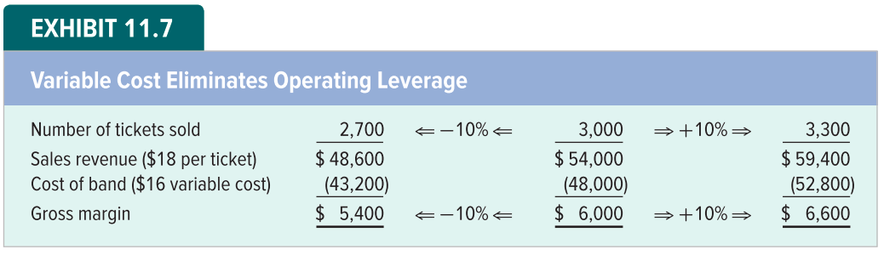
Variable Cost Eliminates Operating Leverage – Decrease in Sales

Slide 17
Variable Cost Eliminates Operating Leverage – Increase in Sales

Slide 18
LO 11-3:
Prepare an income statement using the contribution margin approach.

Slide 19
Contribution Margin Approach
The impact of cost structure on profitability is so significant that managerial accountants frequently construct income statements that classify costs according to their behavior patterns
Such income statements first subtract variable costs from revenue
The resulting subtotal is called the contribution margin.
The contribution margin is the amount available to cover fixed expenses and provide profits.

Slide 20
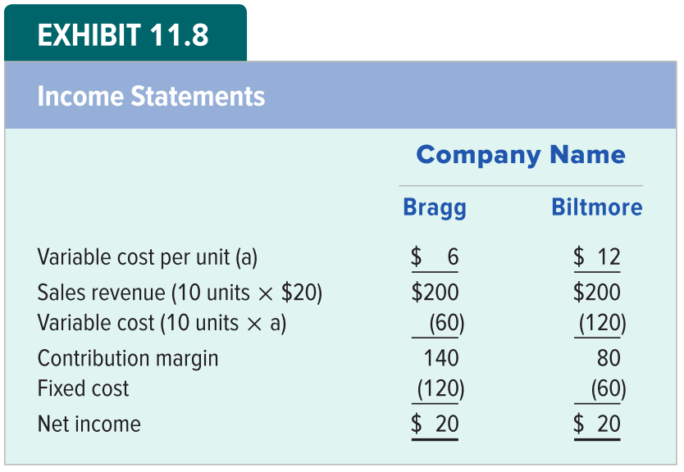
An Income Statement under the Contribution Margin Approach

Slide 21
LO 11-4:
Calculate the magnitude of operating leverage.

Slide 22

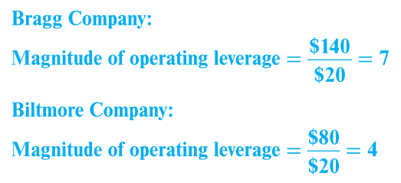
Calculating Magnitude of Operating Leverage
A contribution margin income statement allows managers to easily measure operating leverage as follows:
Applying this formula to the income statement data reported for Bragg and Biltmore Companies in Exhibit 11.8 produces the following measures:

Slide 23
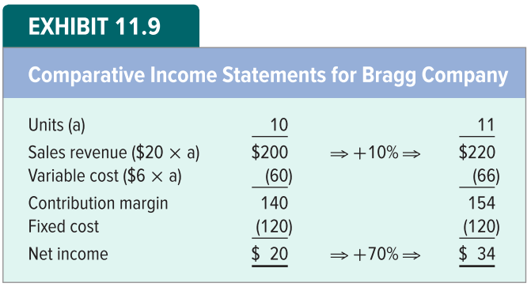
Operating Leverage for Bragg Company
The computations show that Bragg is more highly leveraged than Biltmore. Bragg’s change in profitability will be 7 times greater than a given % change in revenue.

Slide 24
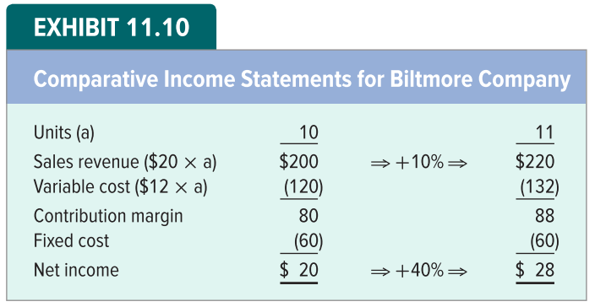
Operating Leverage for Biltmore Company
Biltmore’s profits change by only 4 times the percentage change in revenue.

Slide 25
Measuring Operating Leverage Using Contribution Margin Concluded
Operating leverage itself is neither good nor bad; it represents a strategy that can work to a company’s advantage or disadvantage, depending on how it is used.
Shifting the cost structure from fixed to variable reduces not only the level of risk but also the potential for profits.

Slide 26
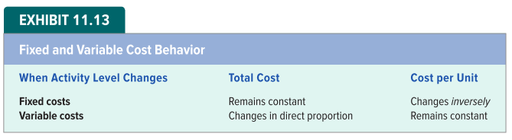
Fixed and Variable Cost Behavior

Slide 27
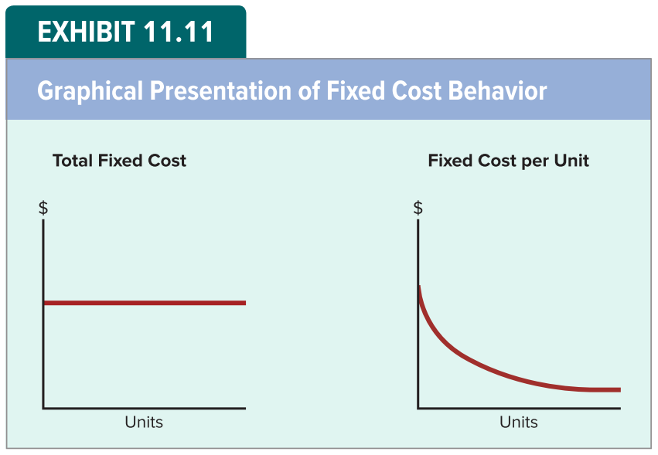
Cost Behavior Summarized – Fixed Costs
The term fixed refers to the behavior of total fixed cost. The cost per unit of a fixed cost varies inversely with changes in the level of activity.

Slide 28
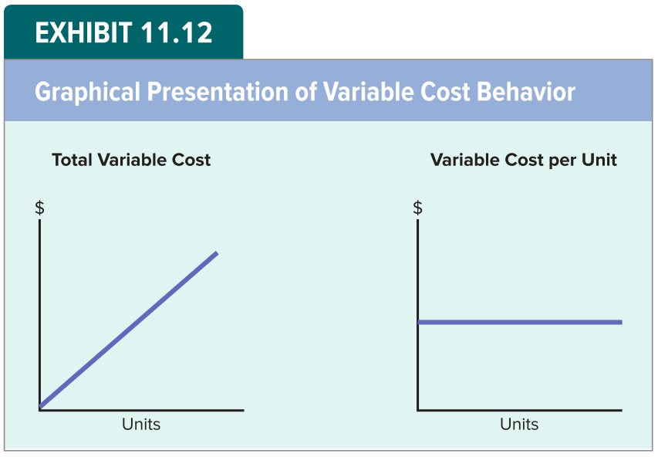
Cost Behavior Summarized – Variable Costs
The term variable refers to the behavior of total variable cost. Total variable cost increases or decreases proportionately with changes in the volume of activity.

Slide 29
Mixed Costs (Semivariable Costs)
Mixed costs (semivariable costs) include both fixed and variable components.
For example, suppose Star Productions pays a base fee of $1,000 plus $20 per hour for janitorial services.
The $1,000 base fee is fixed. It is the same no matter how many hours it takes to clean.
The $20 hourly cost is a variable cost because the total cost increases with each additional hour it takes to complete the cleanup.

Slide 30
Calculating Mixed Costs
Given the $1,000 base plus $20 per hour cost components, the total janitorial cost for any cleanup is:
If 60 hours are required, the total mixed cost is:
If 90 hours are required, the total mixed cost is:

Slide 31
LO 11-5:
Determine the sales volume necessary to break even or to earn a desired profit.

Slide 32
Determining the Break-Even Point
Bright Day Distributors obtained the rights to distribute the new herb mixture Delatine.
The selling price is $36 per bottle and the cost is $24 per bottle.
Bright Day suspects that enthusiasm for Delatine will abate quickly.
To attract customers, the marketing manager suggests an advertising campaign at an estimated cost of $60,000.

Slide 33
The Equation Method
At the break-even point:
Sales = Variable cost + Fixed cost
The equation method begins by expressing the above relationship as follows:
Sales - Variable cost - Fixed cost = Profit (Net Income)
At the breakeven point, profit = 0

Slide 34
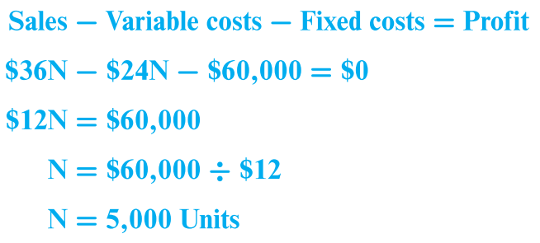
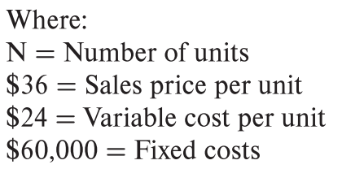
Equation Method
The equation method begins by expressing the income statement as follows:
Profit at the break-even point is zero. The break-even point for Delatine is computed as follows:

Slide 35
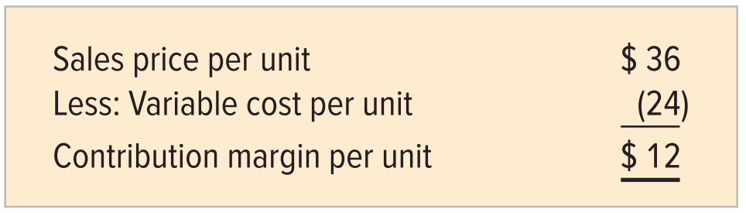
Contribution Margin per Unit Method
The contribution margin per unit for Delatine is:
Every time Bright Day sells a bottle of Delatine, it receives enough money to cover the variable cost of the bottle ($24) and still has $12 left to go toward paying the fixed cost.

Slide 36

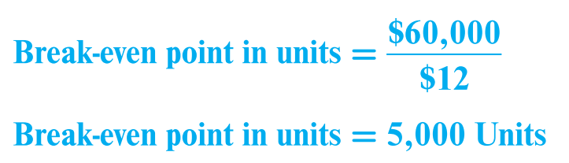
Contribution Margin per Unit Method
The break-even point can be determined as follows:
The result is the same as that determined under the equation method.

Slide 37
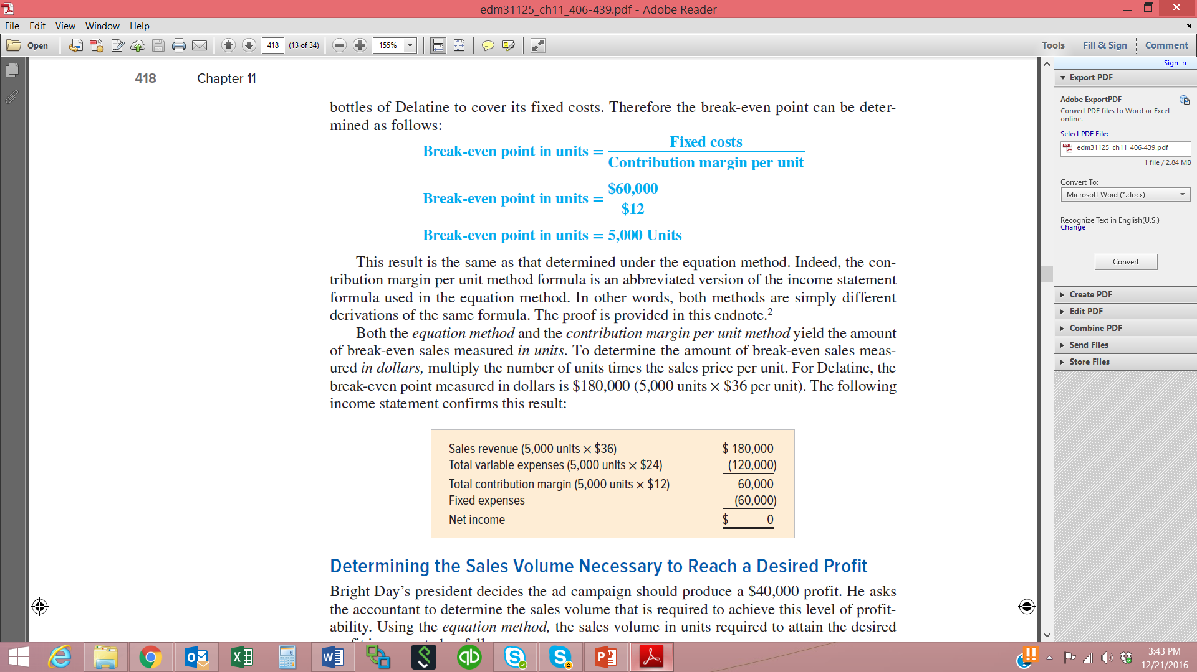
Determining Break-even Volume in Dollars
To determine the amount of break-even sales measured in dollars, multiply the number of units times the sales price per unit.
For Delatine, the break-even sales measured in dollars is $180,000 (5,000 units × $36):

Slide 38
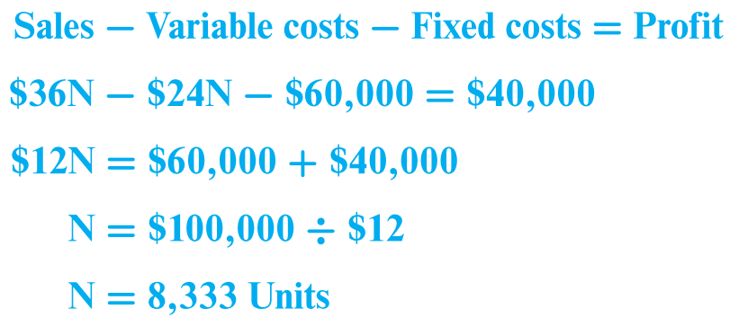
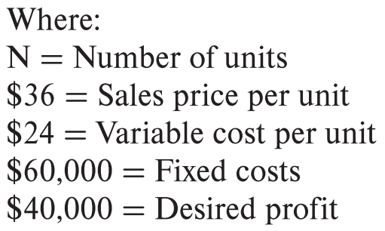
Determining the Sales Volume Necessary to Reach a Desired Profit
A variation of the equation method can be used to determine sales volume necessary to reach a desired profit.
If Bright Day desires to earn a profit of $40,000, the company would need to sell 8,333 bottles of Delatine:

Slide 39
LO 11-6:
Calculate and interpret the margin of safety measure.

Slide 40
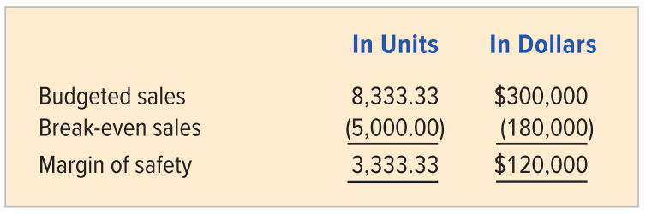
Calculating the Margin of Safety
The margin of safety measures the cushion between budgeted sales and the break-even point. It quantifies the amount by which actual sales can fall short of expectations before the company will begin to incur losses.

Slide 41
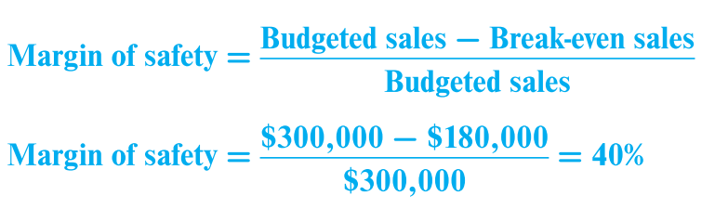
The Margin of Safety as a Percentage of Sales
To help compare diverse products or companies of different sizes, the margin of safety can be expressed as a percentage. Divide the margin of safety by the budgeted sales volume.

Slide 42
Calculating the Margin of Safety Continued
Margin of
safety
Budgeted sales - Break-even sales Budgeted sales
=
Margin of
safety
$300,000 - $180,000 $300,000
=
= 40%

Slide 43
End of Chapter 11

